Slide 1
TWO-LAYER HYDROGENATION THEORY
v.heral@centrum.cz
Notes:
Dámy a pánové, předmětem mého vystoupení je několik poznámek k teorii hydrogenace a konkrétně hydrogenaci alfa-olefinů neboli 1-alkenů.
​
136 / 5 000
Výsledky překladu
Výsledek překladu
Ladies and gentlemen, the subject of my presentation is a few remarks on the theory of hydrogenation and specifically the hydrogenation of alpha-olefins (or 1-alkenes).

Slide 2
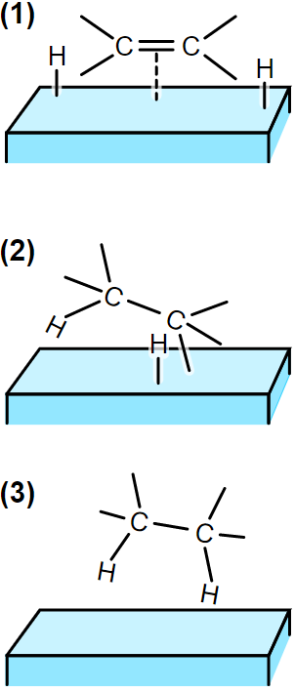
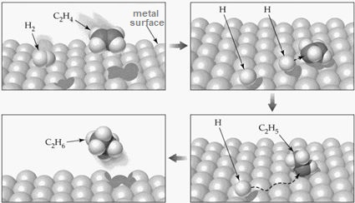
Horiuti-Polanyi (1934)
Theory of semi-hydrogenated state
We have a lot of objections.
Notes:
Dámy a pánové, předmětem mého vystoupení je několik poznámek k teorii hydrogenace a konkrétně hydrogenaci alfa-olefinů neboli 1-alkenů.
​

Slide 3
We object…
Catalytic hydrogenation is the syn-addition of an entire hydrogen molecule, both hydrogens approaching from the same side.
Running across the surface… Can fragments of molecules travel across the surface at all, as Horiuti-Polanyi mechanism requires?
Running across the surface… The principle of microscopic reversibility says that if the reaction runs in one direction over certain intermediates, then the reaction in the opposite direction will run over the same intermediates.
On a platinum catalyst, the hydrogenation of mixtures of H2 + D2 molecules produces a product which contains either none or two deuterium atoms.
Metal catalyst deprived of hydrogen loses its ability to isomerize, but its ability to hydrogenate is preserved.
Hydrogenation and isomerization appear to be two parallel reactions, essentially independent of each other.

Slide 4
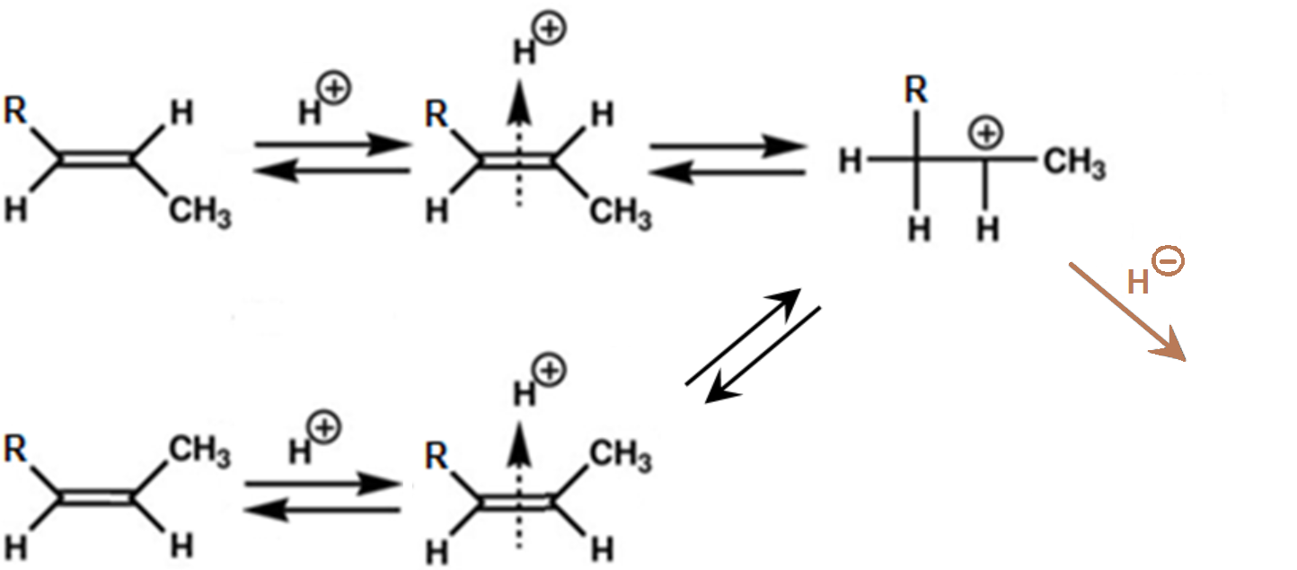
General
Chemistry
Isomerization of Alkene
carbocation
catalyzed by acidic hydrogen H⁺ (proton)
easy, bidirectional, leads to an equilibrium of isomers
trans-
π-complex
H⁺
?
cis-
cis-/trans isomeration
double bond shift
H/D izotopic exchange
Routes of isomerization:

Slide 5
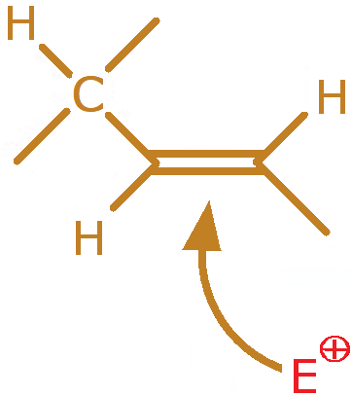
General
Chemistry
Isomerization of Alkene
trans-
trans-
π-complex
carbocation
?
cis-
The release of the double bond rotation appears to be conditioned by the positive charge on the radical

Slide 6
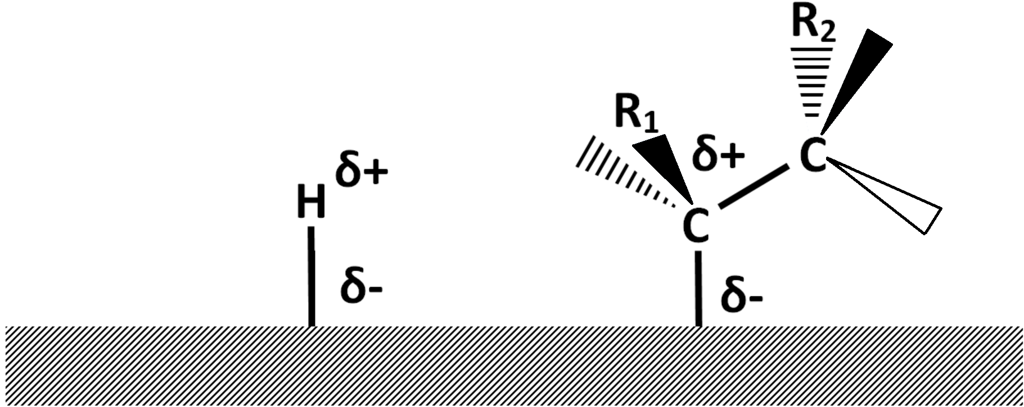
Proton character of atomic hydrogen
on the catalytic surface
Nernst equation
Hydrogen dissolved in the metal travels under the effect of an electric current, proof of its presence in „metallic“ (or proton, H⁺) form
extreme solubility, Pd₂H
10⁻⁷cm³ H₂
per
1cm³ Pt
Pt
Pd

Slide 7
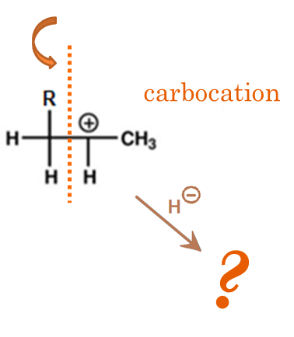
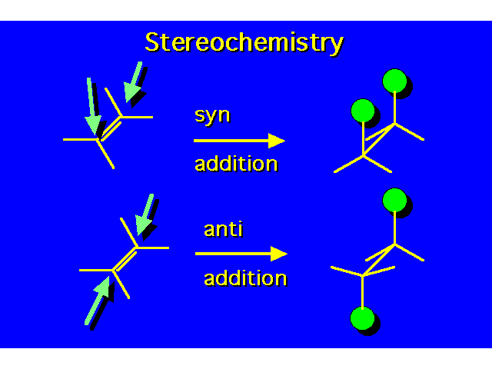
General
Chemistry
Ionic Hydrogenation
of Substituted Alkenes
R₁CH=CH₂+H⁺ ←→ R₁CH₂CH₂⁺
R₁CH₂CH₂⁺ + „H^{-“} ─→ R₁CH₂CH₃
Ionic hydrogenation of the C=C bond is only possible if the bond is conjugated with f. e. a carbonyl, carboxyl, aromatic ring…
In contrast, catalytic hydrogenation of isolated C=C bonds is easy.
Ionic hydrogenation is a anti-addition, each hydrogen approaching from the opposite side of the double bond. Acid – base reaction.
Catalytic hydrogenation is the syn-addition of an entire hydrogen molecule, both hydrogens approaching from the same side.
H⁻ donor: complex hydride, hydrazine, formaldehyde, formic acid…

Slide 8
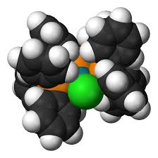
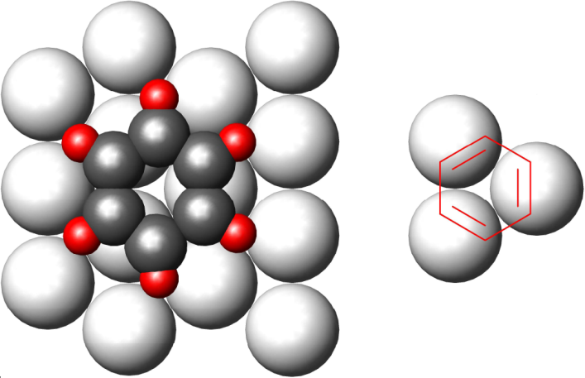
Other objection: multiplexes
Homogeneous hydrogenation of 1-alkene is catalyzed by complexes containing a single transition metal atom.
Wilkinson´s
Origin of multiplex theory: but
In fact, 1 metalic atom per 1 double bond (albeit conjugated here)

Slide 9
Alternative?
Two-layer Theory
Olefin is adsorbed on a metal surface: п-complex (a)
Hydrogen is adsorbed in the second layer (b)
Transient state (c)
The saturated molecule leaves the surface (d).
Inspired by Walden's twist

Slide 10
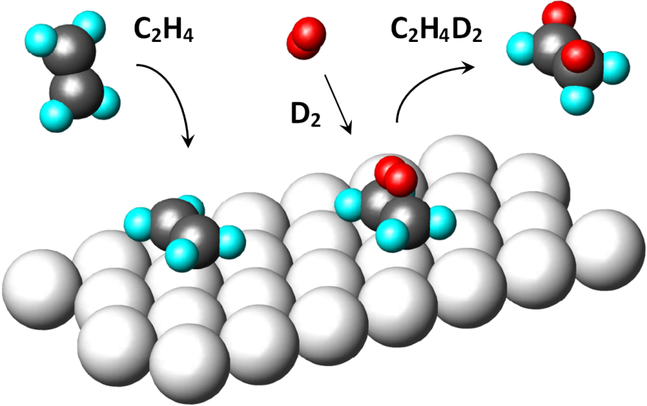
Two-Layer Theory: Hydrogenation
here: Deuteration

Slide 11
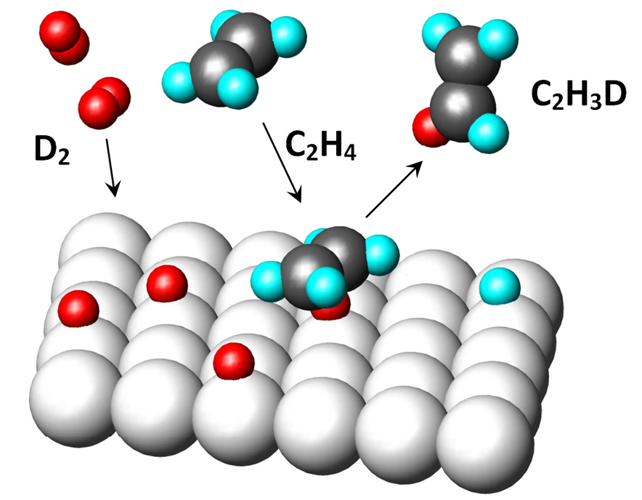
Two-Layer Theory: Isomerization
(here: isotopic exchange) via ⊕ carbocation

Slide 12
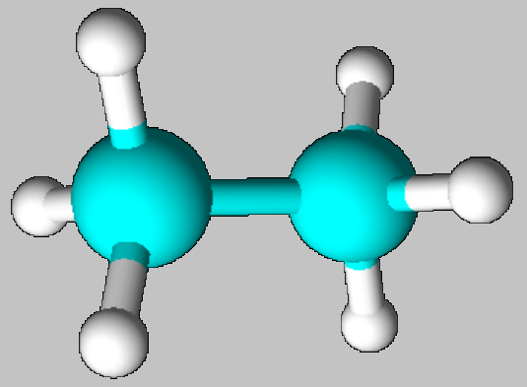
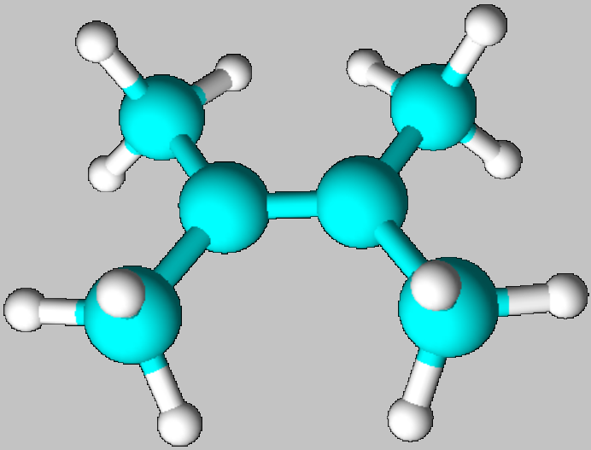
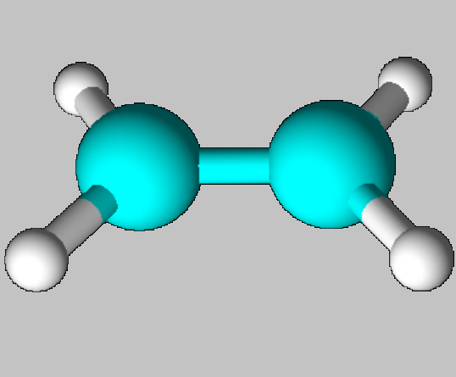
steric hynderance
Triple and quadruple substituted double bonds cannot be hydrogenated for spherical reasons
CATALYST´SURFACE
POSSIBLE < bending of bonds to the surface > IMPOSSIBLE

Slide 13
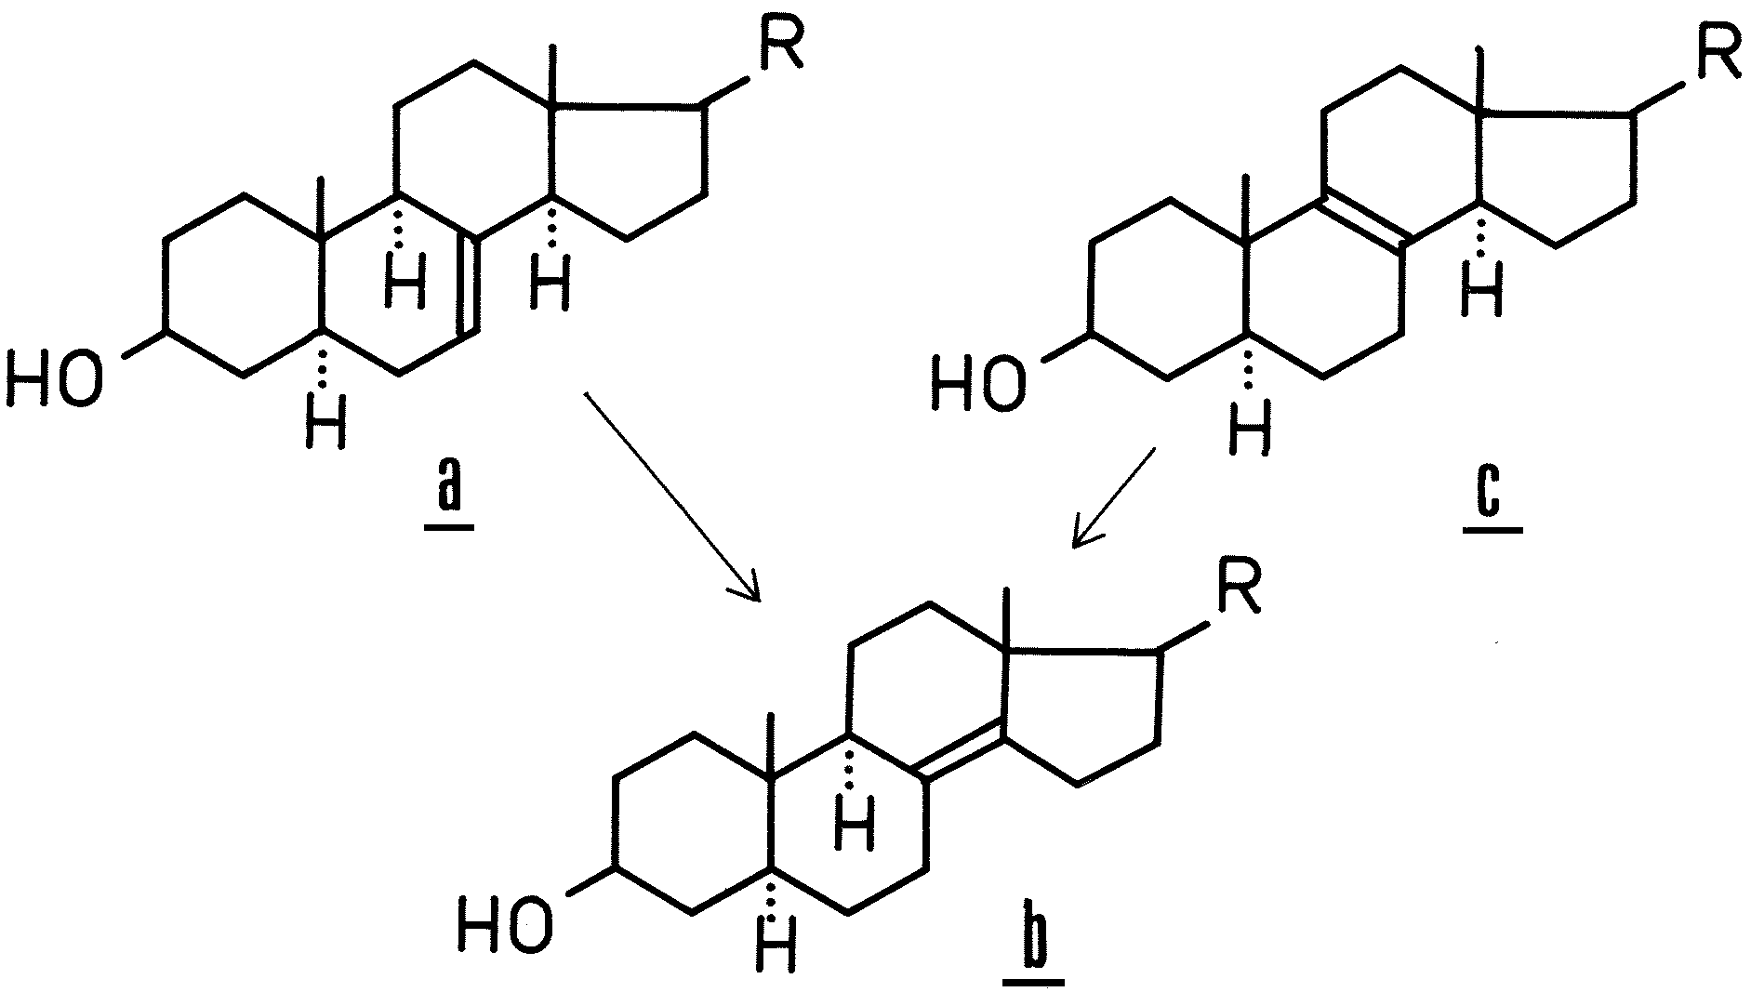
Some structures can be hydrogenated after prior isomerization, but sometimes this is not feasible.

Slide 14
50 years ago
One day my professor told me: In the literature, it is written that by increasing the hydrogen pressure and the alkene concentration, a state can be reached where the rate does not change anymore, when the rate of hydrogenation is zero-order with respect to hydrogen and with respect to the unsaturated substrate .
Look at it.

Slide 15
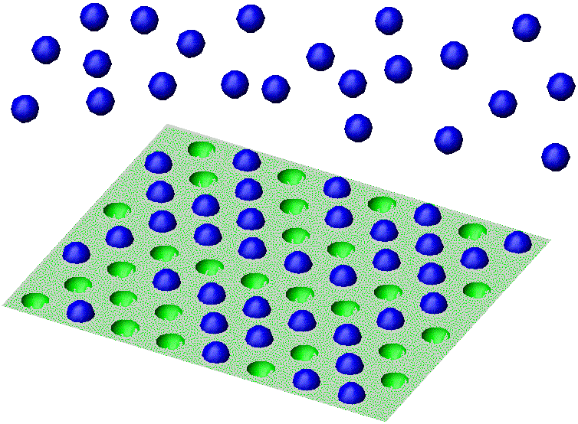
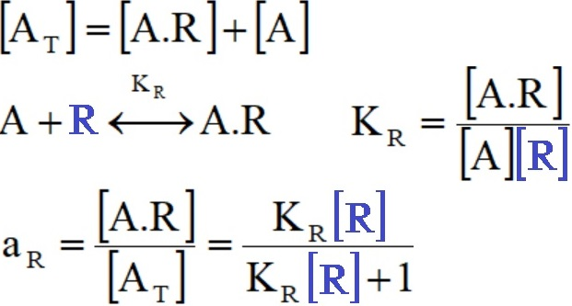
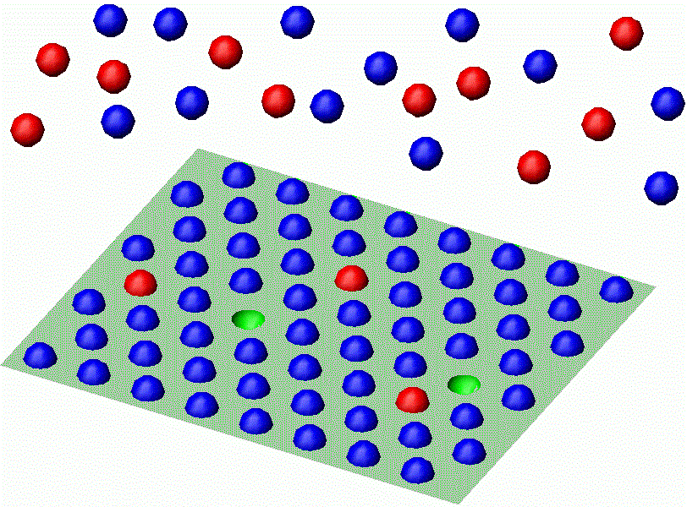
General
Chemistry
Langmuir and Hinshelwood´s
Kinetic model
[A.R] | [A]
[A_{T}]
a_{R}=36/64=0.56
[A.R] | [A.S] | [A]
[A_{T}]
a_{R}=59/64; a_{S}=3/64
r=k∙a_{R}∙a_{S}

Slide 16
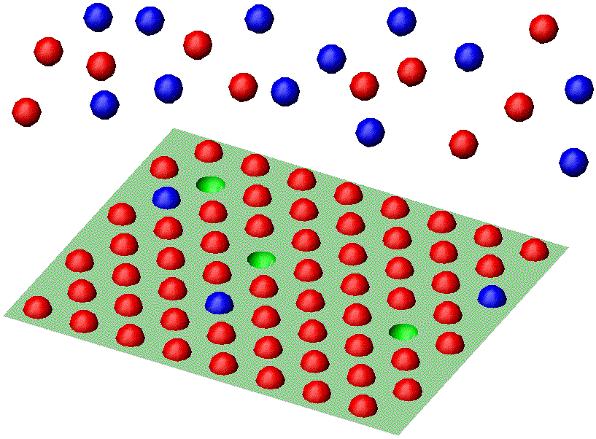
r=k∙a_{R}∙a_{S}
k_{R}=k/(K_{R}[R])
k_{S}=k/(K_{S}[S])
In competitive adsorption in one layer, the reaction cannot be at the same time of zero order with respect to both components.

Slide 17
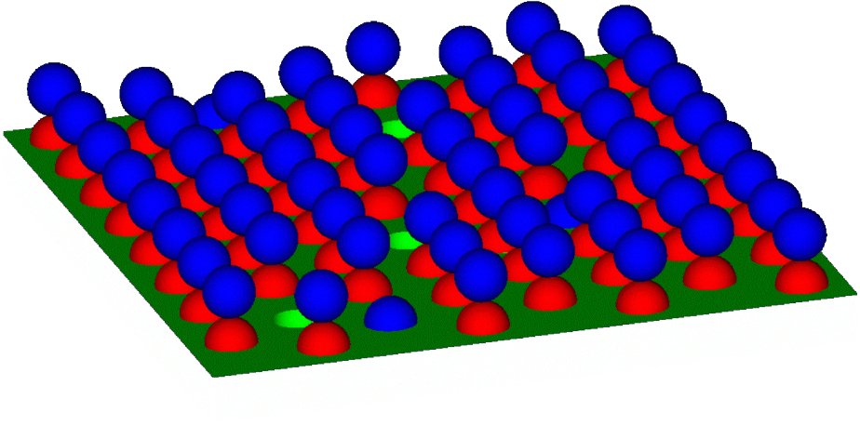
? New starting point: TWO-LAYER theory ?
Zero order to both components
is possible.
Assume that the rate-determining step is the conversion of the surface complex A.R.H₂
Surface complexes:
[A.R]_{T}
K_{R}
K_{H}
K_{H2}

Slide 18
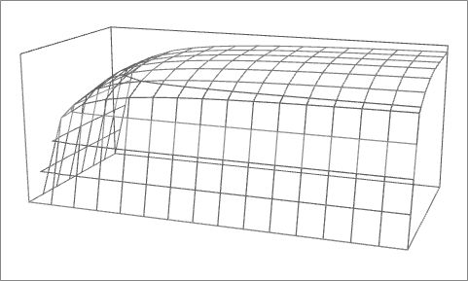
1-alkene conc.c
H2 pressure P_{S}
RATE
r ← k∙P_{S}⁰∙c⁰
K_{R} = 100
K_{H} = 0.06
K_{H2} = 0
K_{RH2} = 2
P_{S} [0..15]
c [0..1]
c=1
time
CONVERSION
PRESSURE
c=0
Unfortunately, the reality seems to be more complicated…But I think: we will proceed further if we exclude the half-hydrogenated state - if we consider isomerization and hydrogenation to be
independent reactions

Slide 19
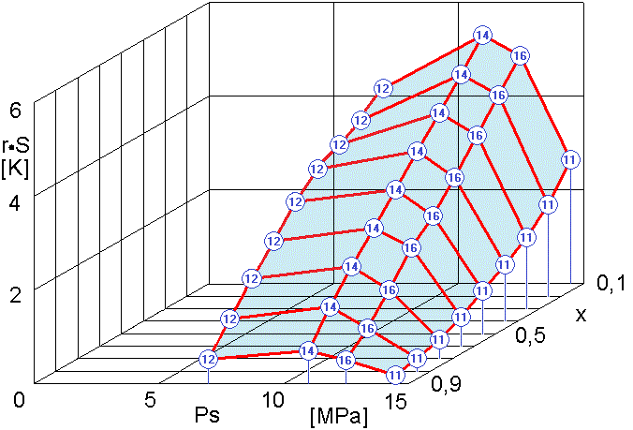
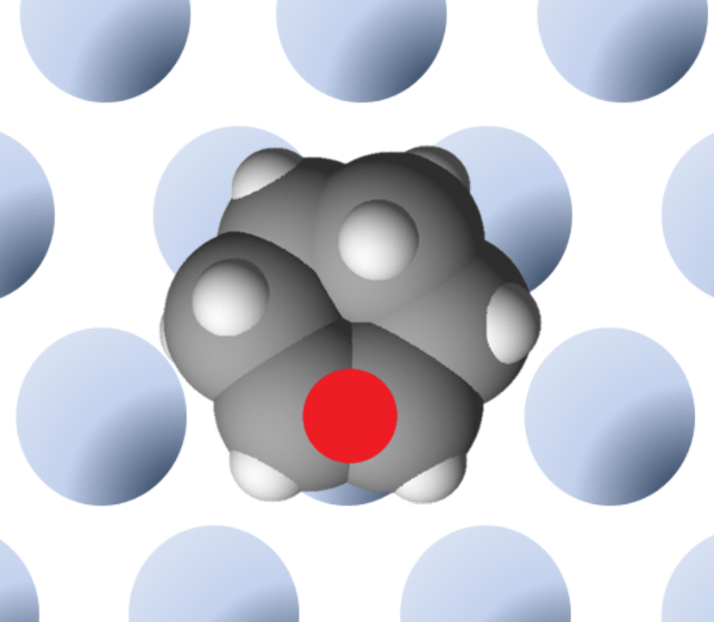
Unfortunately, the reality seems to be even more complicated…
Hydrogenation of cyclohexene (25 mL) in isopropanol (25 mL ), 40 mg 5% Pt/C (Riedel-de Haën No. 64154), rate corrected to kinetic conditions at 40°C. The vertical axis (R.S) expresses the relative rate as a function of hydrogen pressure (Ps) and conversion (x).
Test numbers (No.) and pressure:
(12) 7.0, (14) 11.0, (16) 12.5, (11) 14.5 MPa
In this case, the previous rate equation does not hold.
The reason is perhaps an incorrect balance of active centers: While hydrogen really occupies one surface metal atom (●), cyclohexene, in addition to its own adsorption bond (●) prevents adsorption on other atoms, in our case, this molecule blocks ~ 3 atoms of the catalyst. However, I am not able to find the correct rate equation.

Slide 20
That´s all.
Based on our student work: V.Heral, Effect of pressure on the course of hydrogenation in solution, VŠCHT Prague 1973 (unpublished).
Extended reading: http://cz.9e.cz/hgb

